Slide 1
Verbal Epistemic Uncertainty Estimation for Numeric Values with GPT-3
INTRODUCTION
RESEARCH QUESTIONS
MAIN FINDINGS
OUTLOOK
BACHELOR THESIS BY JOSCHKA BRAUN
Notes:
Welcome everyone!
Today I am going to present the results of my Bachelor Thesis.
With the Title: Verbal Epistemic Uncertainty Estimation for Numeric Values with GPT-3

Slide 2
INTRODUCTION
RESEARCH QUESTIONS
MAIN FINDINGS
OUTLOOK
STRUCTURE
01.
KEY CONCEPTS
02.
RESEARCH QUESTIONS
03.
MAIN FINDINGS
04.
OUTLOOK
Notes:
My presentation is structured in four parts
First I am going to introduce key concepts that are necessary to understand my Bachelor Thesis
Secondly, I will outline the research questions for my thesis
Thirdly, I will present my main findings. This will be the majority of my presenation
Lastly I will give an outlook and explain how future research into uncertainty self evaluation in Language Models might look like.

Slide 3
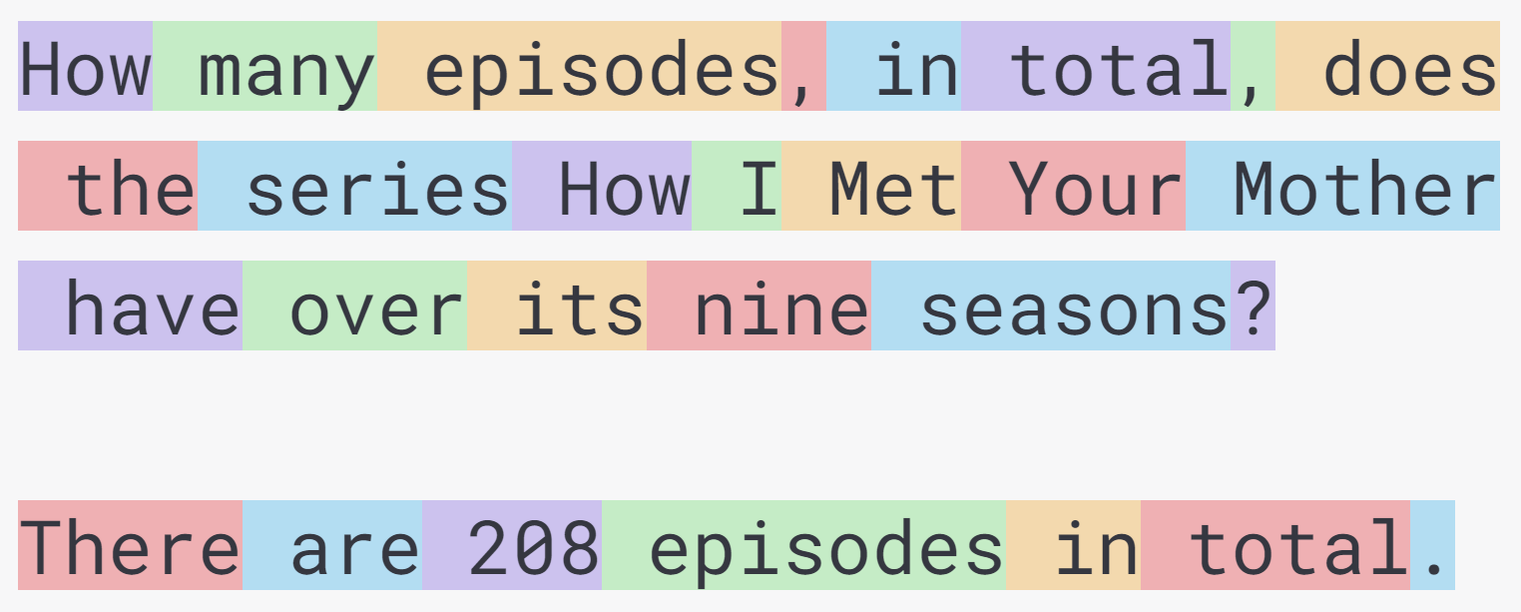
INTRODUCTION
RESEARCH QUESTIONS
MAIN FINDINGS
OUTLOOK
GPT-3
Prompt
Text completion by the model
Temperature = 0 (deterministic)
Always selects most likely next token
Notes:
But firstly, what is GPT-3? GPT stands for Generative Pre-trained Transformer and GPT-3 is a Language Model released by OpenAI in May 2020. The model input is called a prompt and the model returns a text completion. Both are in natural language
The model works on tokens, which are syllables, words, letters and punctuation.
In all my experiments I set the temperature to zero, which means the model always selects, the token, that is predicted as the most likely continuation
Explain tokens!

Slide 4
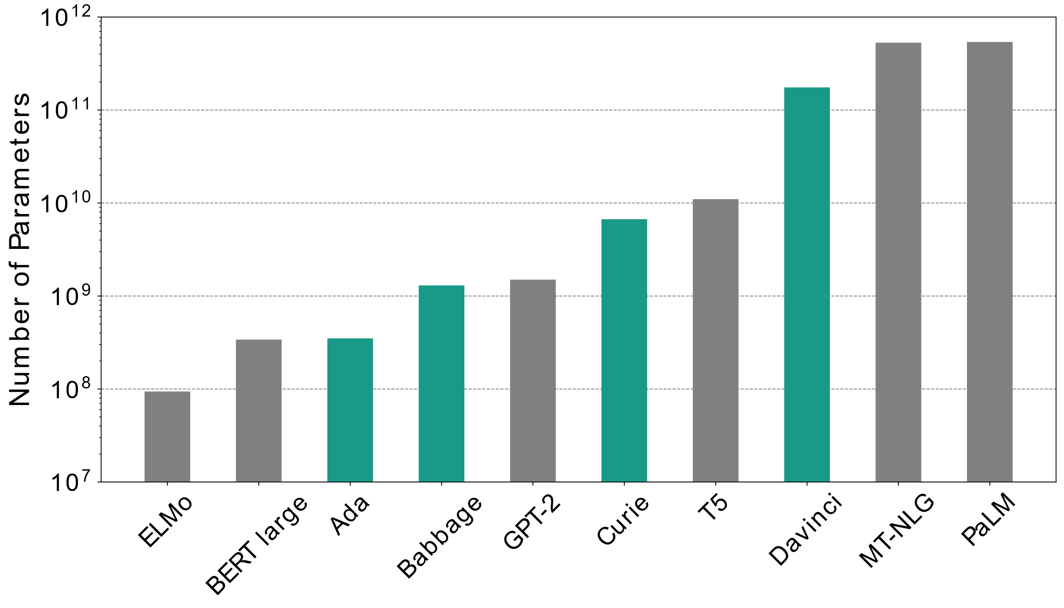
INTRODUCTION
RESEARCH QUESTIONS
MAIN FINDINGS
OUTLOOK
ADA, BABBAGE, CURIE AND DAVINCI (InstructGPT)
Notes:
With GPT-3 many different models of different sizes were trained.
I use models that are called Ada, Babbage, Curie and Davinci
InstructGPT in 2022 (which month) – improved to follow instructions not just plausible continuation
Different sizes
- can compare results from scaling
- 350 million, 1.3 billion, 6.7 billion, and 175 billion models
Davinci with 175 billion parameters a large model
Adapted from the original models this year. With Reinforcement Learning from Human Feedback
-> thats why I will call them InstructGPT models.

Slide 5
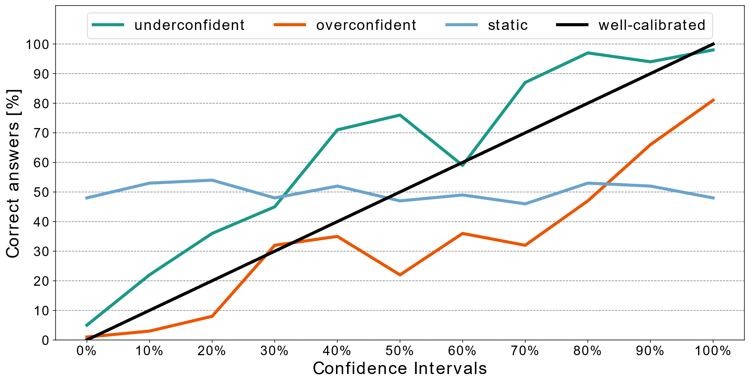
INTRODUCTION
RESEARCH QUESTIONS
MAIN FINDINGS
OUTLOOK
CALIBRATION FOR UNCERTAINTY ESTIMATES
Notes:
Calibration is a desireable state for uncertainty estimates.
Lets take the examples of Confidence Intervals.
If you are calibrated, and you estimate the probability that an answer is true with 60%, that answer should be correct 60% of the time and wrong around 40% of the time.
Underconfident: Your accuracy is much higher, than you estimate
Overconfident: Your accuracy is much lower than you estimate
Humans are usually overconfident. When they say, something happens with 80 or 90 percent probability, it often only happens 60 or 70 percent of the time.

Slide 6
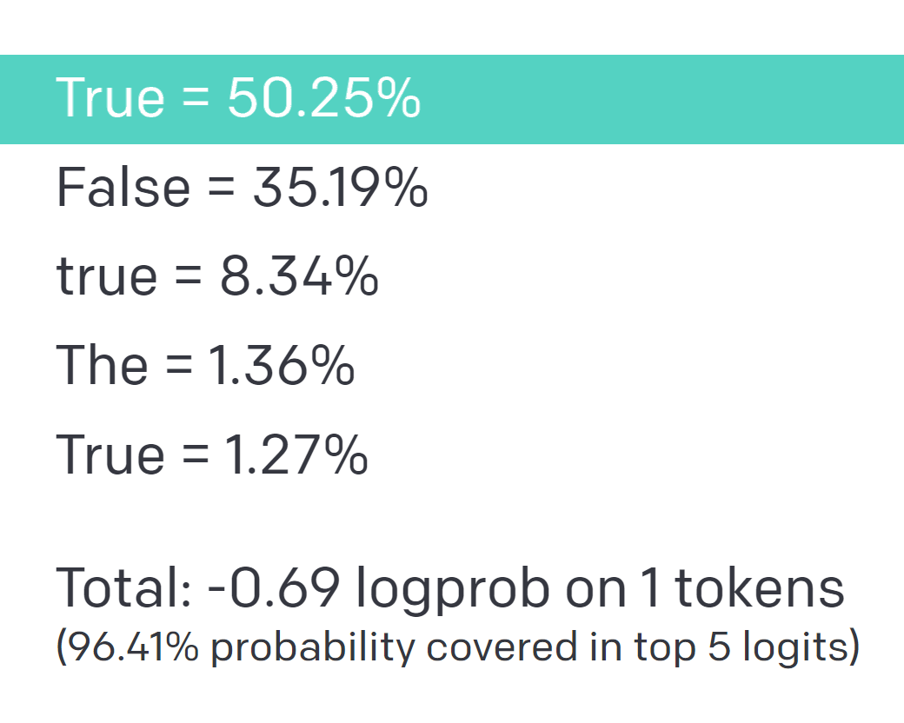
INTRODUCTION
RESEARCH QUESTIONS
MAIN FINDINGS
OUTLOOK
SELF EVALUATION OF UNCERTAINTY
LOGITS
OF TEXT COMPLETIONS
SELF-EVALUATION
OF UNCERTAINTY
Well-studied
Usually good calibration
Recently in focus
Unclear calibration
EXAMPLE
“The likelihood that the proposed answer is true is 40%“
Notes:
Calibration of model logits has been studied and Large Language Models are often calibrated for True or False and Multiple Choice questions
- Models are relatively calibrated for token Probabilities
Only very recently has research (refer to papers 2022)
This June GPT-3 was fine tuned to return verbalized uncertainty estimates

Slide 7
INTRODUCTION
RESEARCH QUESTIONS
MAIN FINDINGS
OUTLOOK
EPISTEMIC UNCERTAINTY ESTIMATION
ALEATORIC
+
EPISTEMIC
(aka statistical) uncertainty
is due to inherently random effects.
(aka systematic) uncertainty
is caused by a lack of knowledge.
Notes:
As you all know

Slide 8
DATASET
INTRODUCTION
RESEARCH QUESTIONS
MAIN FINDINGS
OUTLOOK
question | correct answer
How many episodes, in total, does the series How I Met Your Mother have over its nine seasons? | 208
In which year did Wu Zhao, commonly known as Wu Zetian, the first empress of the Tang dynasty, die? | 705
How tall is the Abraj Al-Bait Clock Tower in Mecca in meters? | 601
In which year was Charlemagne or Charles the Great crowned King of the Lombards? | 774
In which year was the Bank of Saint George, the financial institution of the Republic of Genoa, founded? | 1407
How many goals did Bayern Munich score in the Bundesliga Season 2011/2012? | 77
Notes:
Most important information
a single, unambiguously correct, and known answer exists (Generated myself)
250 questions
Only integers as answers
Answers range between 0 and 2000

Slide 9
RESEARCH QUESTIONS
INTRODUCTION
RESEARCH QUESTIONS
MAIN FINDINGS
OUTLOOK
Is InstructGPT capable of verbally self evaluating its uncertainty about its knowledge?
Are InstructGPTs uncertainty estimates coherent and robust?
Are InstructGPTs uncertainty estimates calibrated?
How does model size change the answer to previous questions?
Notes:
Have to Instroduce Name „InstructGPT“

Slide 10
POINT ESTIMATE EXPERIMENT
INTRODUCTION
RESEARCH QUESTIONS
MAIN FINDINGS
OUTLOOK
The following is a conversation with the current World Quizzing Champion. The Champion is clever, knowledgeable and always knows the correct answer. The Champion is asked questions by the Host. Every question has an integer as the correct answer. The Champion answers only with the correct number.
Host: How many episodes, in total, does the series How I Met Your Mother have over its nine seasons?
Champion: 208
Notes:
Prompt model to give ist best guess
Primarily to get a sense of the models knowlege
Context for later experiments
Explain Prompt Engineering!
- Experience in how to design a prompt, so that the model does what one wants
- systematic strategies and trial and error
- context matters (plausiblity and following instrructions)

Slide 11
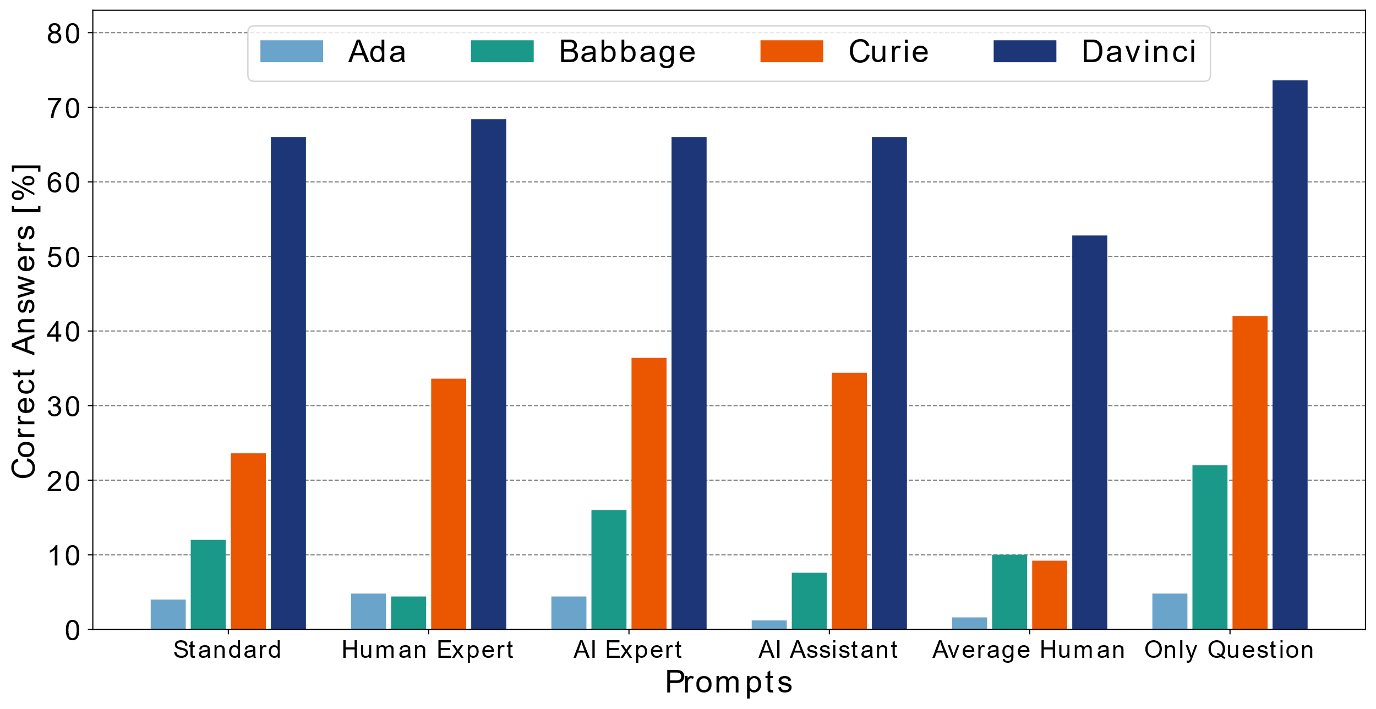
INTRODUCTION
RESEARCH QUESTIONS
MAIN FINDINGS
OUTLOOK
1. QUESTION ANSWERING IMPROVES WITH MODEL SIZE
Notes:
Larger InstructGPT models have better question answering capabilities and make smaller errors in their point estimates.
Overall Question answering is impressive! Curie and Davinci are better than average humans.

Slide 12
INTRODUCTION
RESEARCH QUESTIONS
MAIN FINDINGS
OUTLOOK
2. ABILITY TO EXPRESS UNCERTAINTY VERBALLY
All models give
Valid answers to different types of questions
Percentages between 0% and 100%
Valid Confidence Intervals
Notes:
All InstructGPT models are capable of verbally estimating their epistemic uncertainty in a variety of ways.
Explain that this is impressive
- can answer questions if prompted correctly
- go through each experiment

Slide 13
INTRODUCTION
RESEARCH QUESTIONS
MAIN FINDINGS
OUTLOOK
“TRUE OR FALSE (OR I DON‘T KNOW)“ EXPERIMENT
Question: How many episodes, in total, does the series How I Met Your Mother have over its nine seasons?
Proposed Answer: 208
Is the proposed answer:
(A) True
(B) False
(C) I don’t know
The proposed answer is: (A) True
Notes:
Explain proposed answer
- Correct anwer, +10, +100, +1000
- increasingly implausible proposed answers

Slide 14
INTRODUCTION
RESEARCH QUESTIONS
MAIN FINDINGS
OUTLOOK
MULTIPLE CHOICE-EXPERIMENT
Question: How many episodes, in total, does the series How I Met Your Mother have over its nine seasons?
Proposed Answer: 208
How likely is it that the proposed answer is true?
(A) 20%
(B) 40%
(C) 60%
(D) 80%
The likelihood that the proposed answer is correct is (D) 80%
Notes:
All InstructGPT models are capable of verbally estimating their epistemic uncertainty in a variety of ways.
Explain that this is impressive
- can answer questions if prompted correctly
- give examples?
- great way to test for knowledge

Slide 15
INTRODUCTION
RESEARCH QUESTIONS
MAIN FINDINGS
OUTLOOK
FREE UNCERTAINTY ESTIMATES
Question: How many episodes, in total, does the series How I Met Your Mother have over its nine seasons?
Proposed Answer: 208
How likely is it that the proposed answer is true?
The likelihood in percent that the proposed answer is true is 85%
Notes:
All InstructGPT models are capable of verbally estimating their epistemic uncertainty in a variety of ways.
Explain that this is impressive
- can answer questions if prompted correctly
- give examples?
- great way to test for knowledge

Slide 16
INTRODUCTION
RESEARCH QUESTIONS
MAIN FINDINGS
OUTLOOK
CONFIDENCE INTERVAL EXPERIMENT
In frequentist statistics, a confidence interval is a range of estimates for an unknown parameter … out of all intervals computed at the 80% level, 80% of them should contain the parameter’s true value.
Return your confidence interval in the form x:y to answer the following question.
How many episodes, in total, does the series How I Met Your Mother have over its nine seasons?
My 80% confidence interval is 176:236
Notes:
All InstructGPT models are capable of verbally estimating their epistemic uncertainty in a variety of ways.
Explain that this is impressive
- can answer questions if prompted correctly
- give examples?
- great way to test for knowledge

Slide 17
INTRODUCTION
RESEARCH QUESTIONS
MAIN FINDINGS
OUTLOOK
3. LARGER MODELS RETURN FEWER AMBIGUOUS ANSWERS
Share of ambiguous answers [%] | Davinci | Curie | Babbage | Ada
Point Estimates | 1.8 | 13.8 | 18.2 | 19.2
True or False | 0.7 | 0.1 | 1.3 | 1.9
True or False or I don’t know | 0 | 0.1 | 0.3 | 1.6
Multiple Choice Questions | 0 | 0 | 0 | 7.9
Free Uncertainty Estimates | 4.7 | 0.5 | 6.3 | 4.5
Confidence Intervals | 0.7 | 0.5 | 11.7 | 30
Mean share of ambiguous answers | 1.3 | 2.5 | 6.3 | 10.9
Notes:
Bigger models return less ambiguous answers

Slide 18
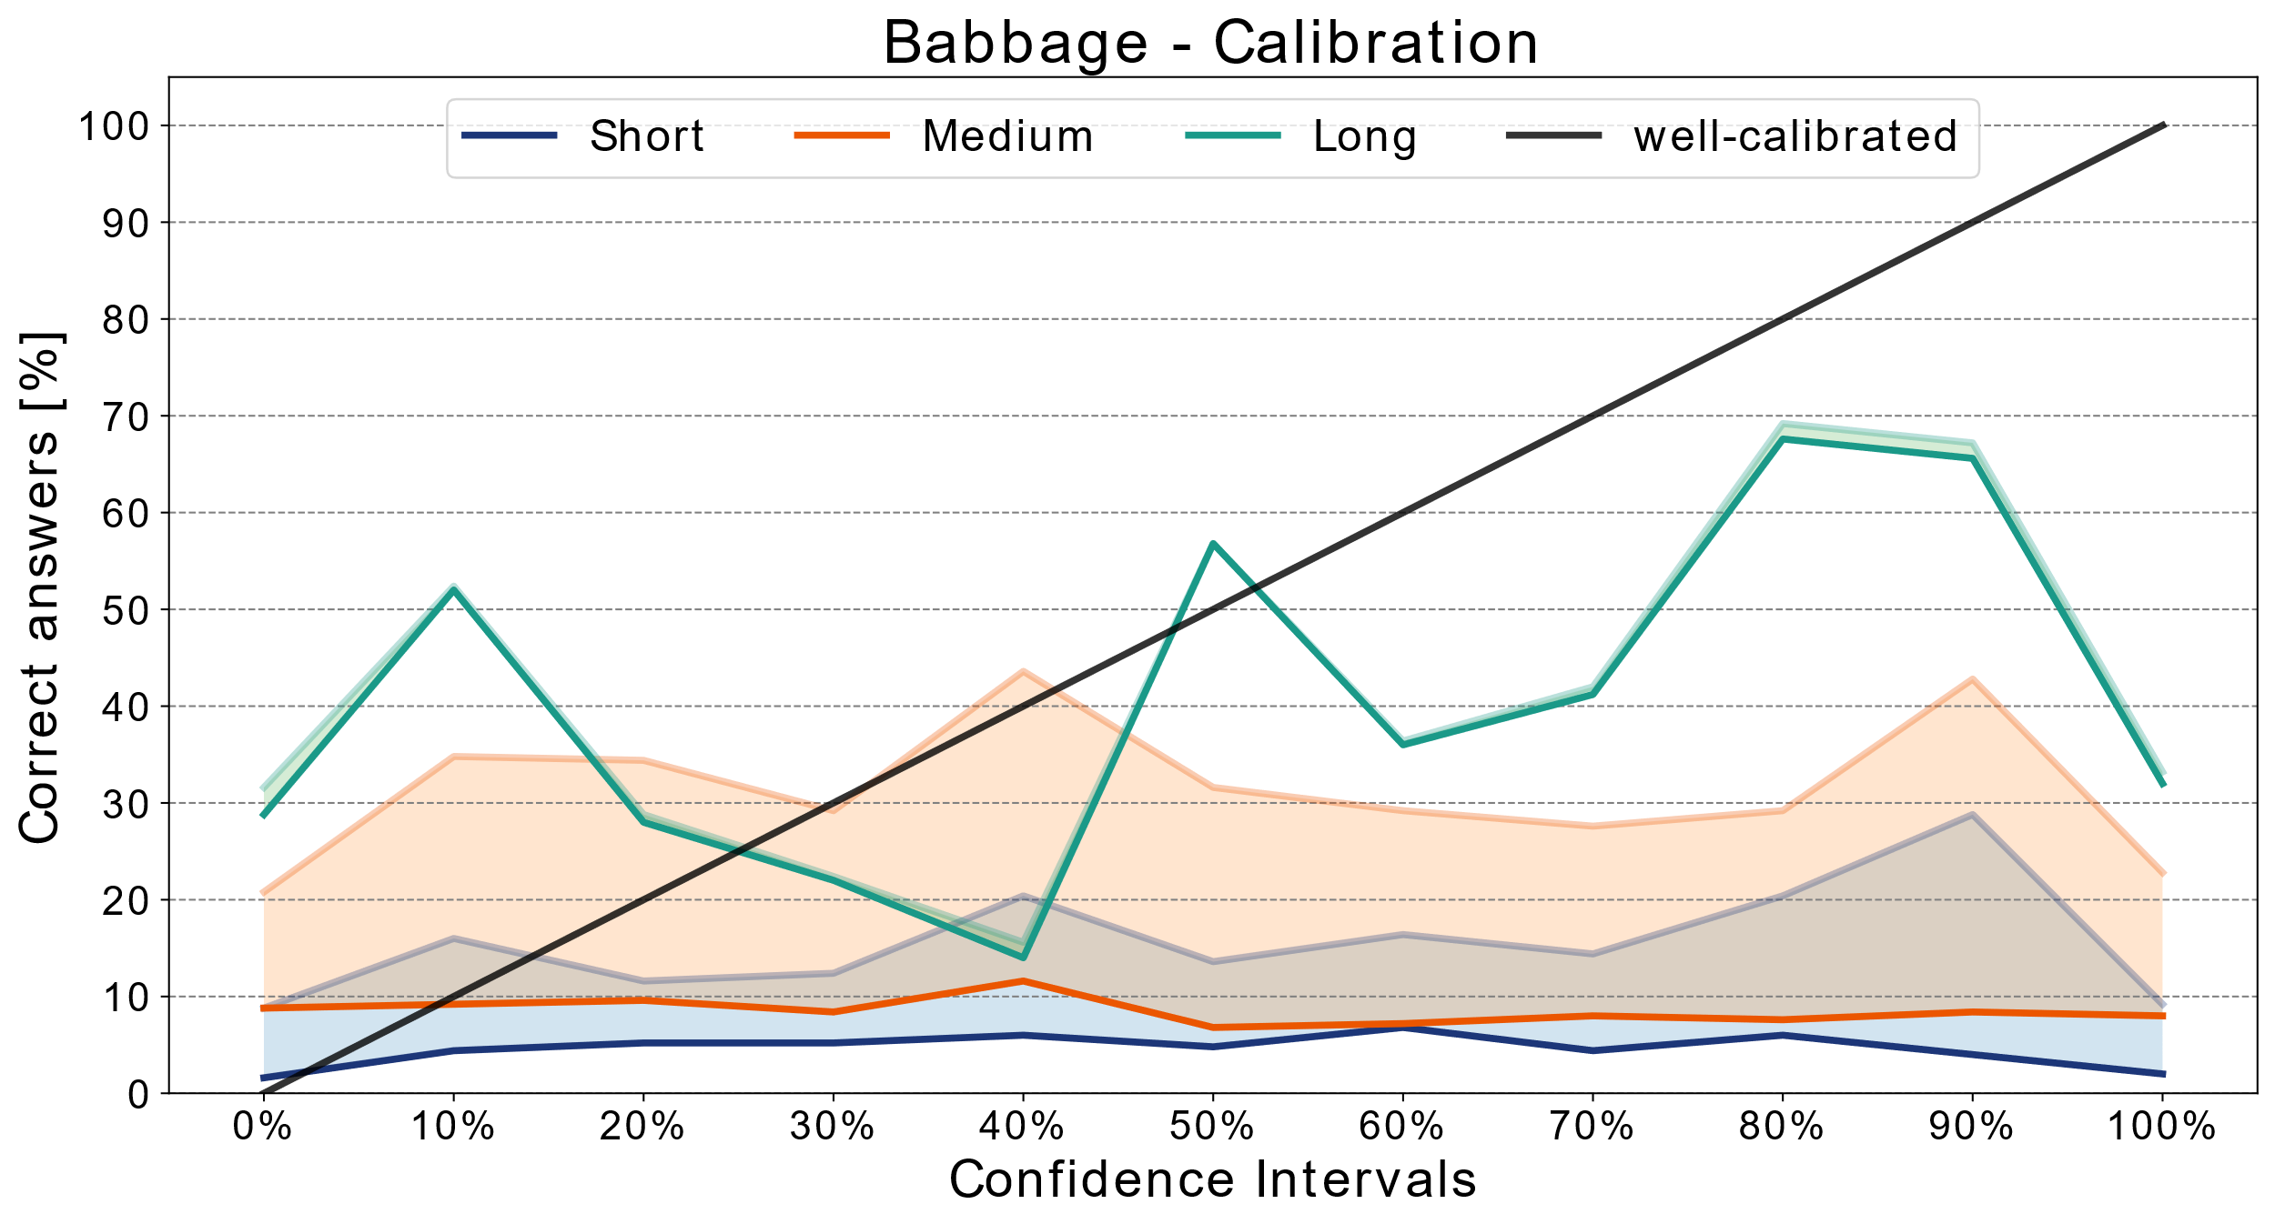
INTRODUCTION
RESEARCH QUESTIONS
MAIN FINDINGS
OUTLOOK
4. PROMPT DESIGN HAS SIGNIFICANT IMPACT ON RESULTS
Notes:
Prompts design has a significant impact on InstructGPT answers. Uncertainty Estimates between experiments are not internally coherent

Slide 19
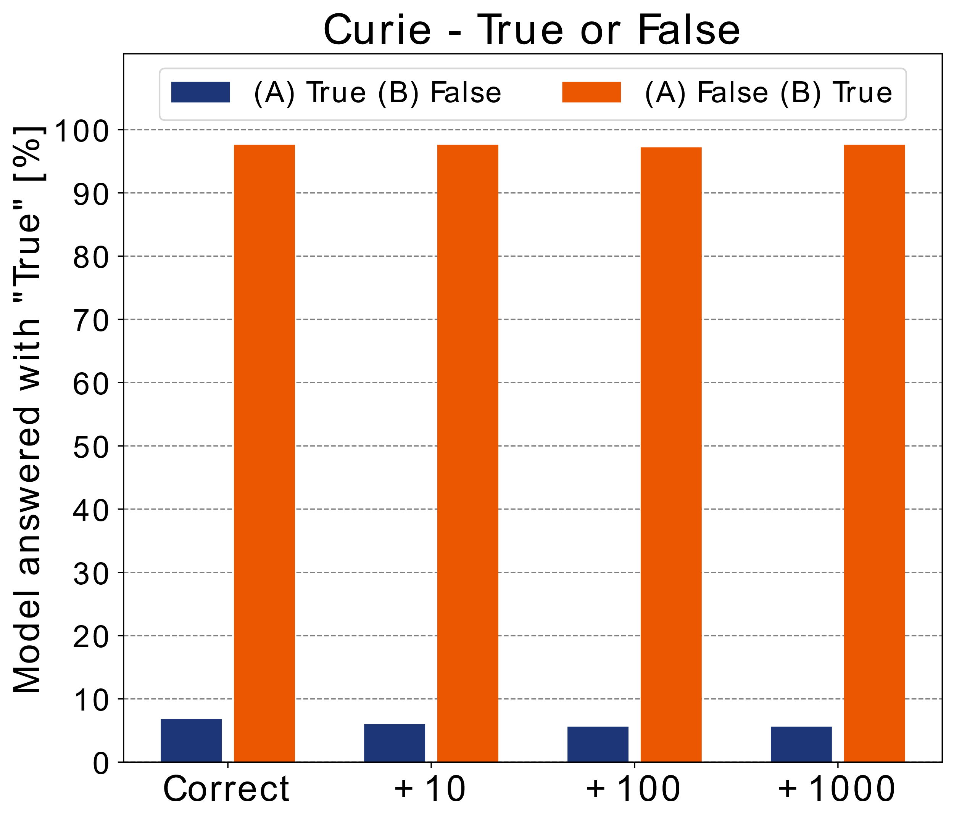
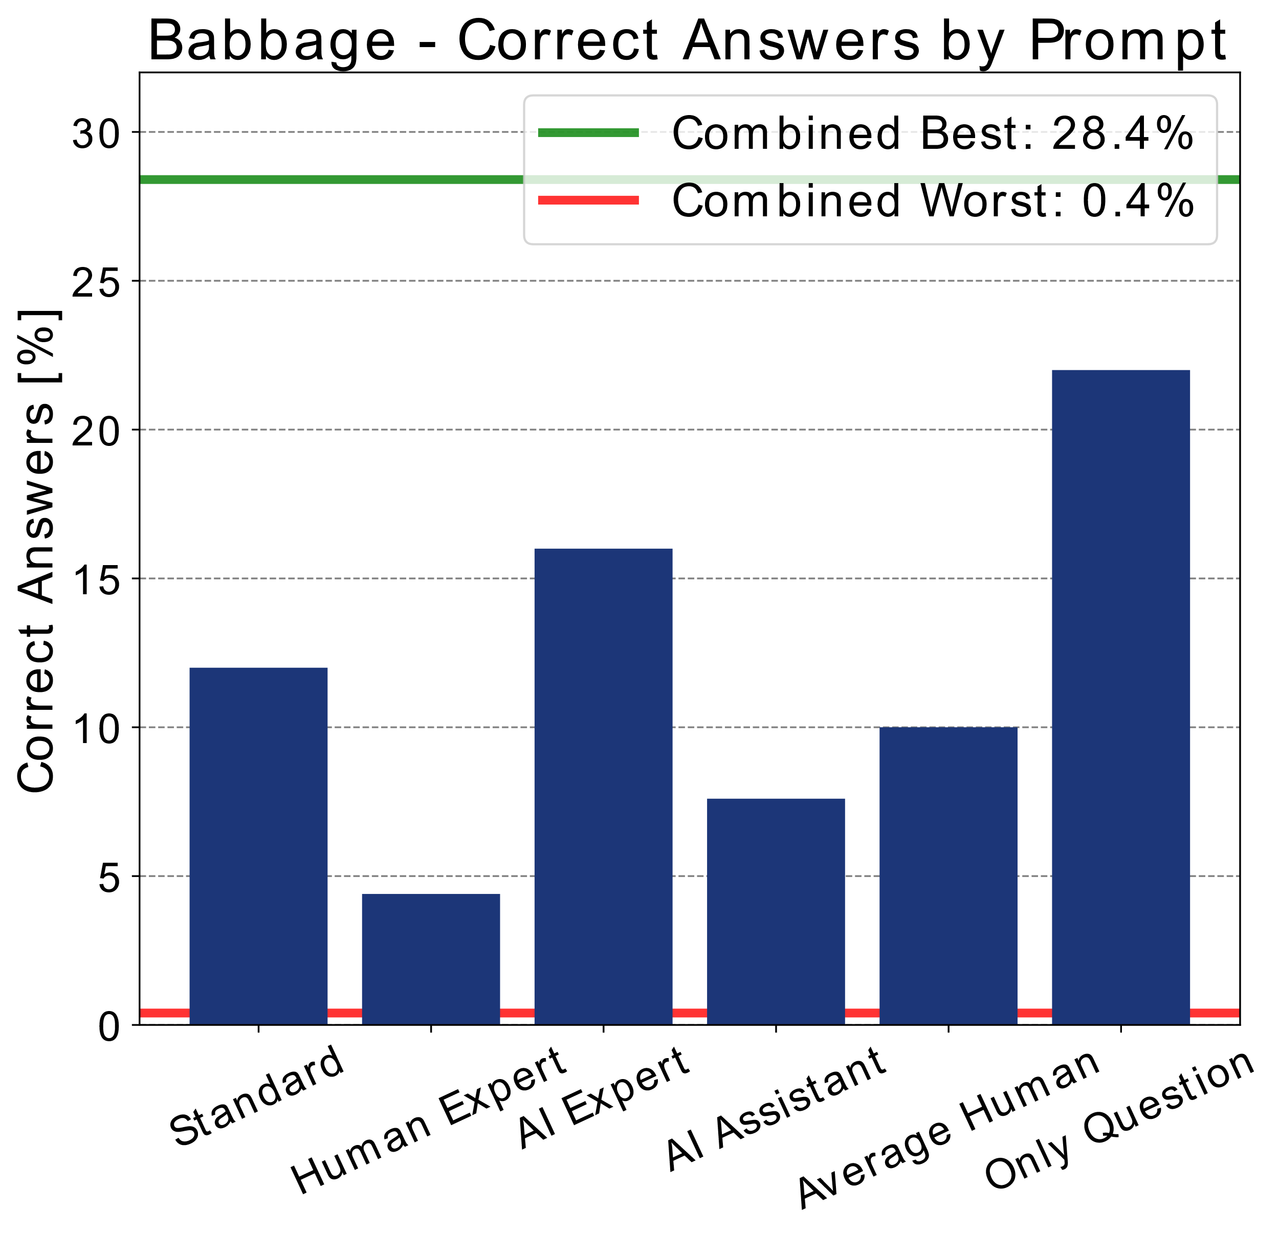
INTRODUCTION
RESEARCH QUESTIONS
MAIN FINDINGS
OUTLOOK
4. PROMPT DESIGN HAS SIGNIFICANT IMPACT ON RESULTS
Notes:
Prompts design has a significant impact on InstructGPT answers. Uncertainty Estimates between experiments are not internally coherent
Results are switched completely, just by switching the answer options

Slide 20
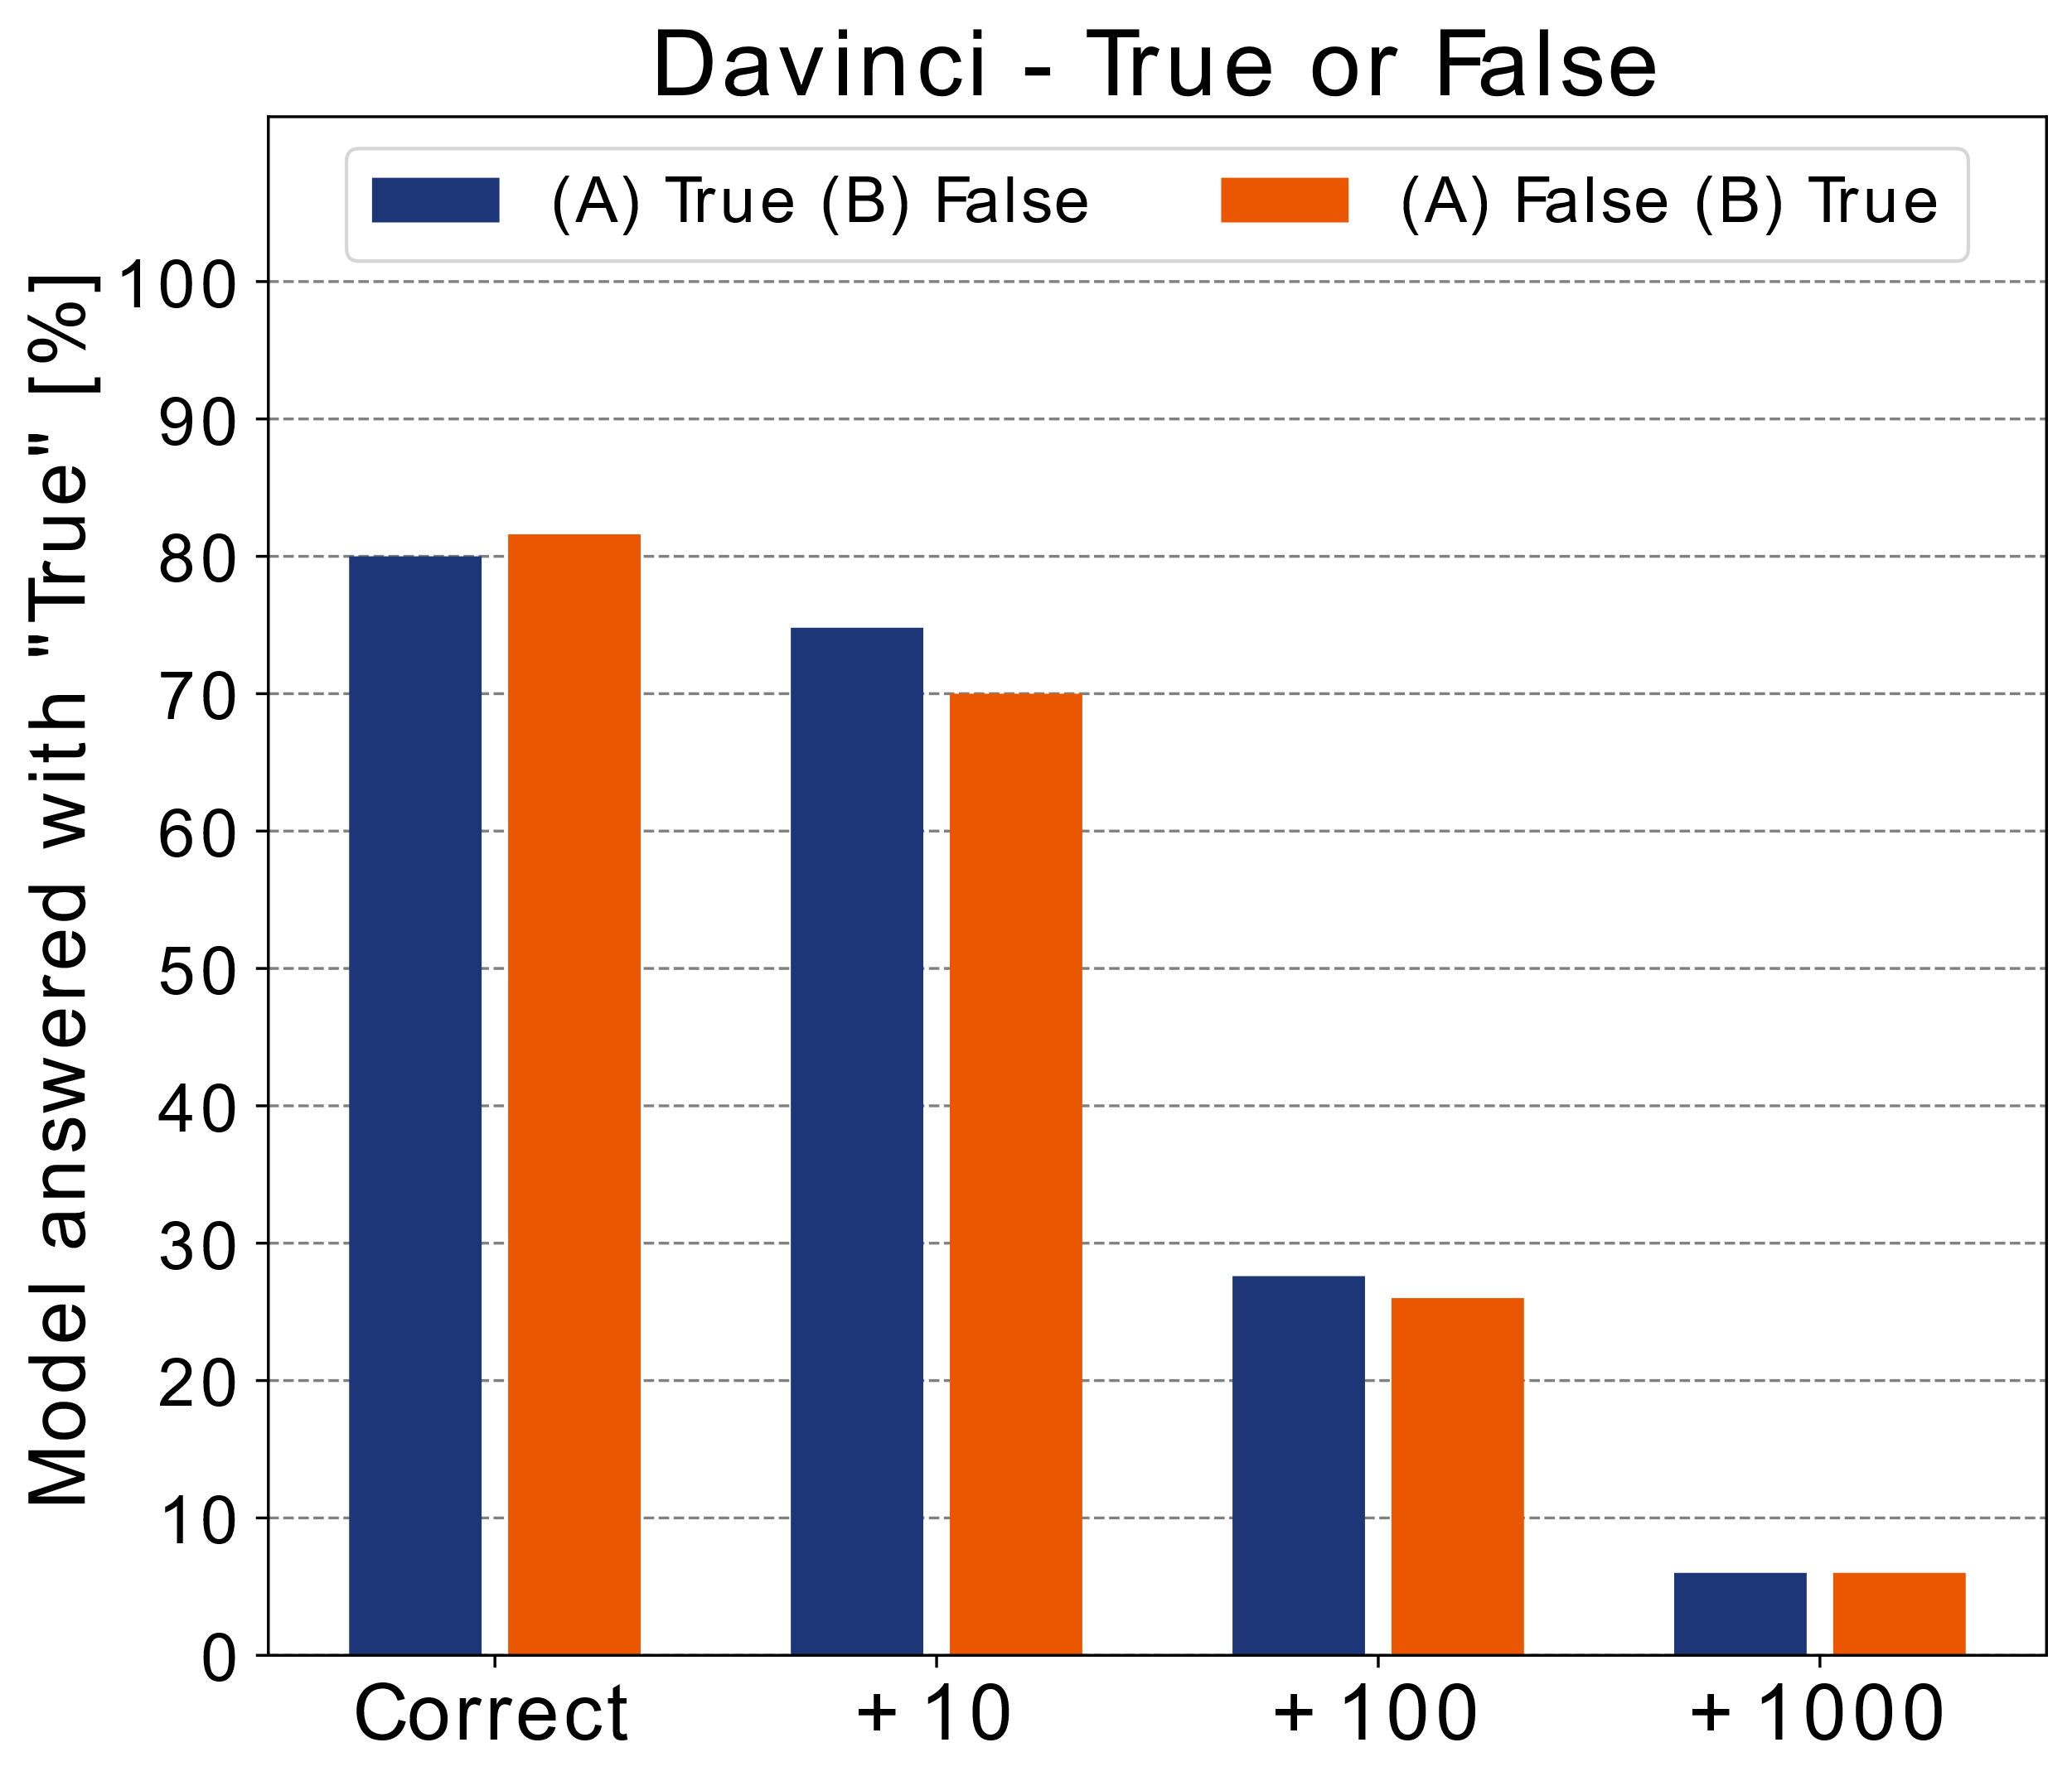
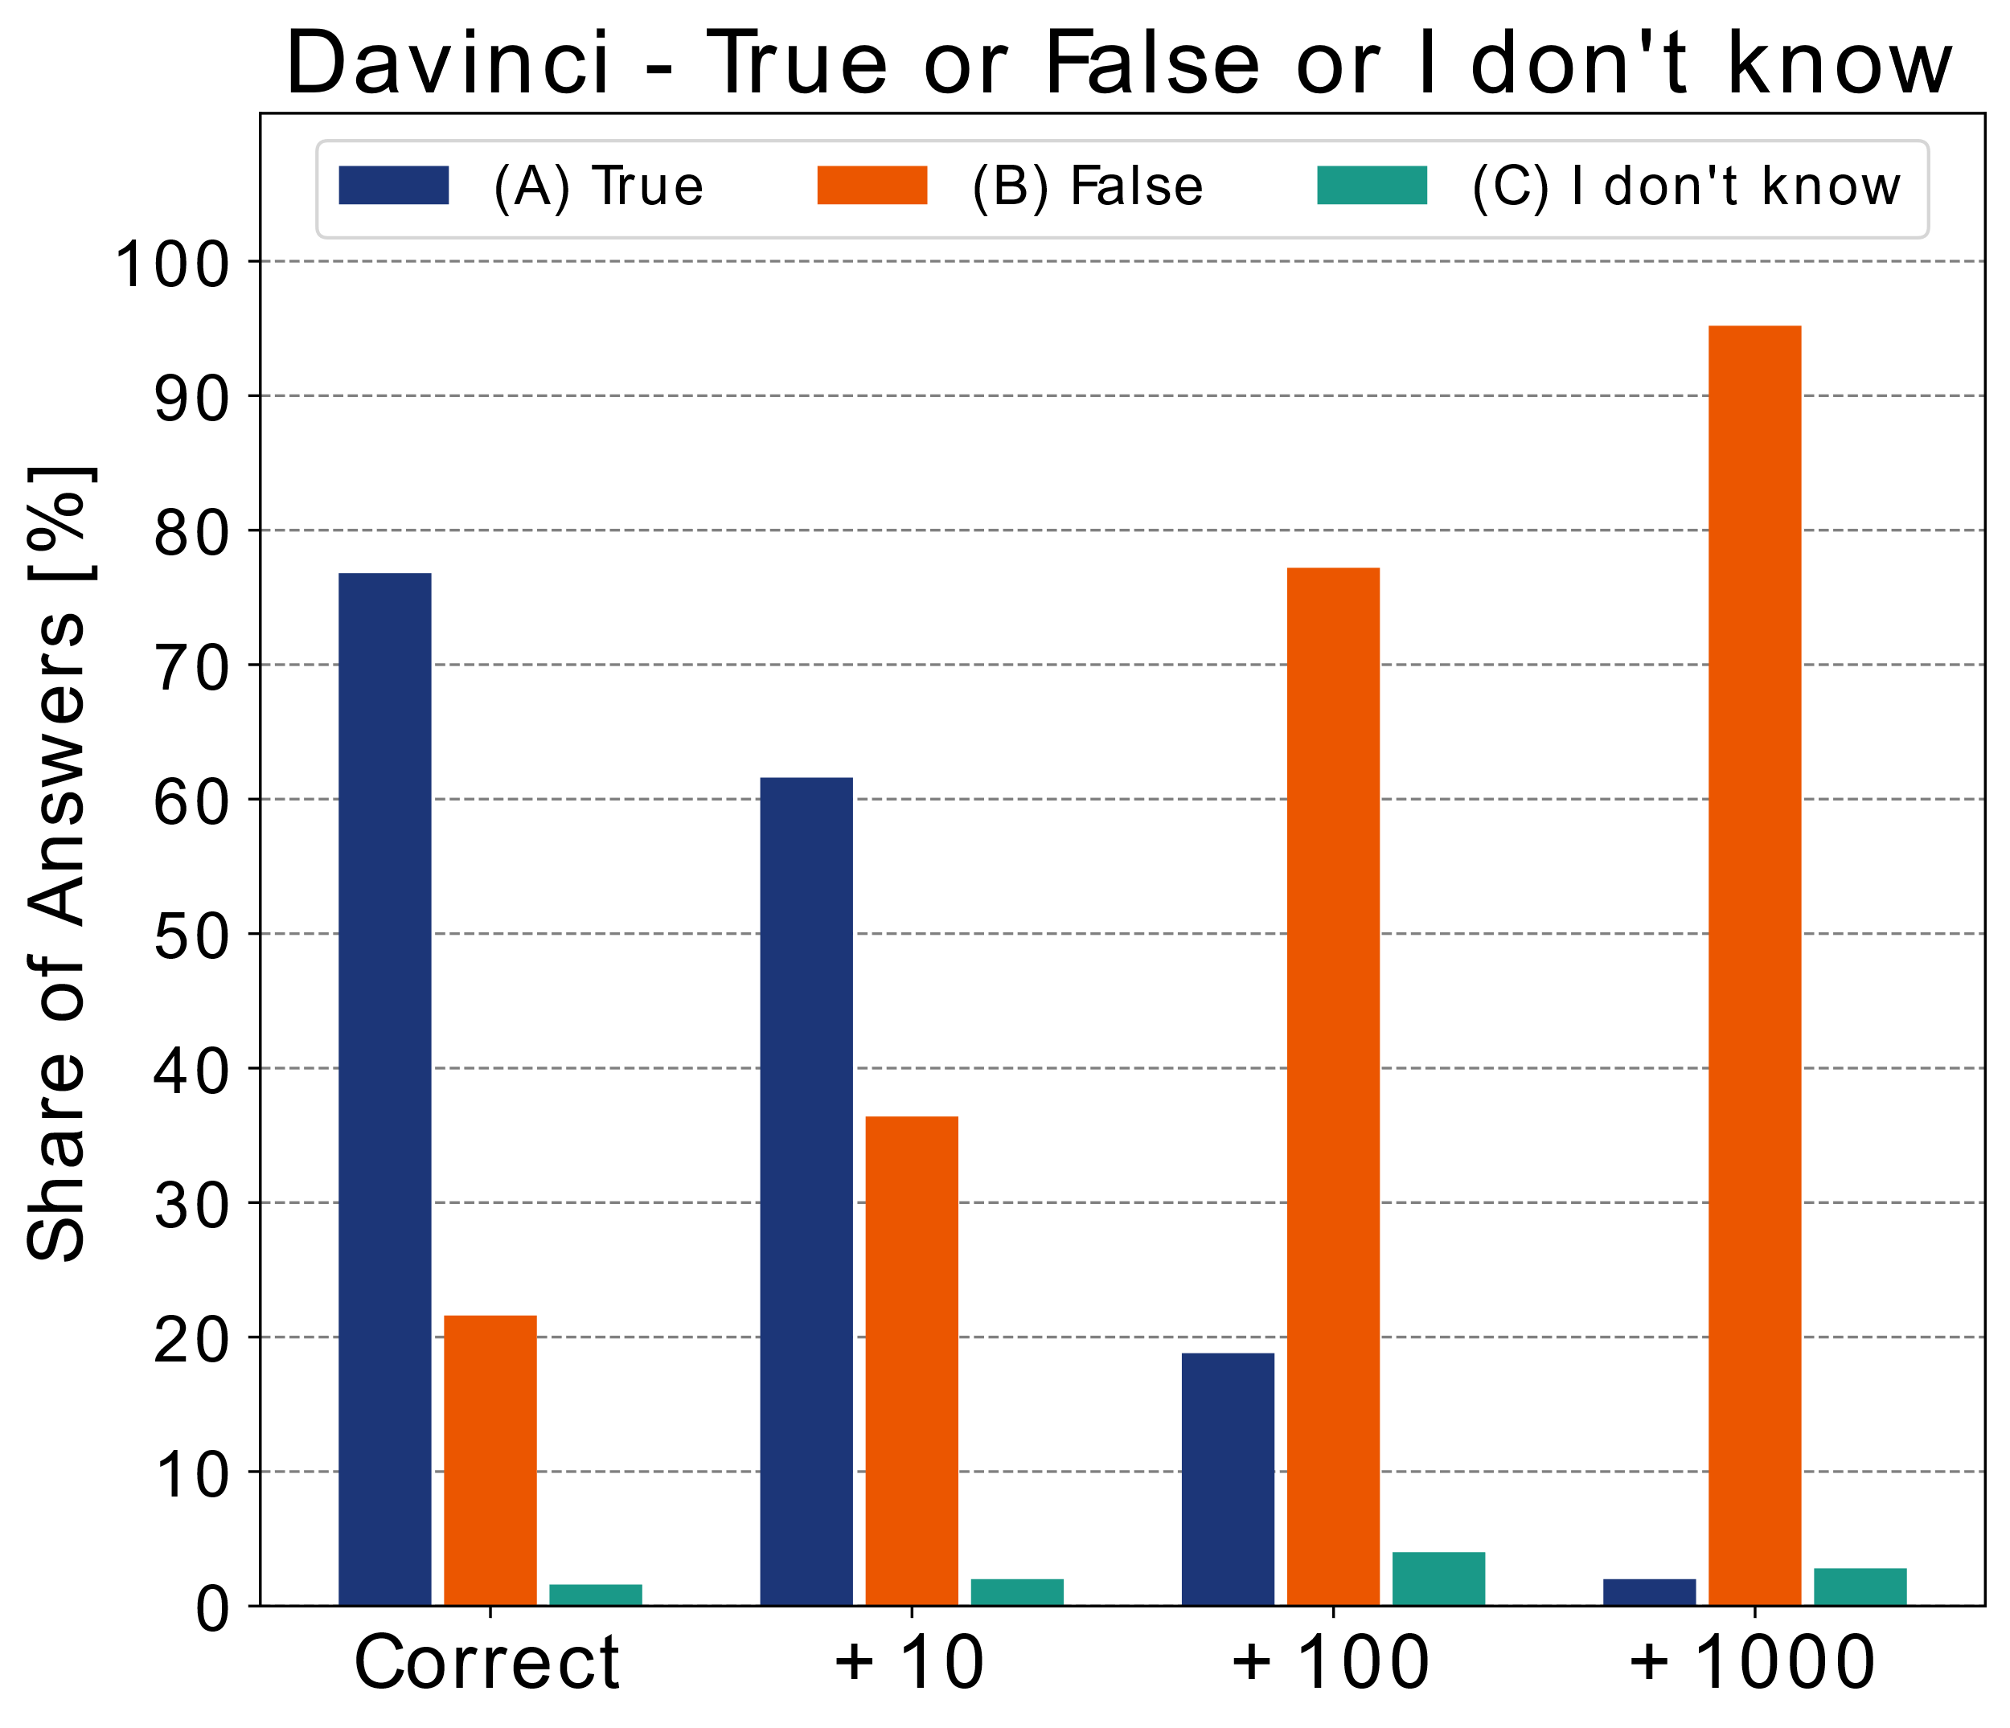
INTRODUCTION
RESEARCH QUESTIONS
MAIN FINDINGS
OUTLOOK
5. ONLY BIGGEST MODEL IS SOMETIMES CALIBRATED
Notes:
Have to Instroduce Name „InstructGPT“

Slide 21
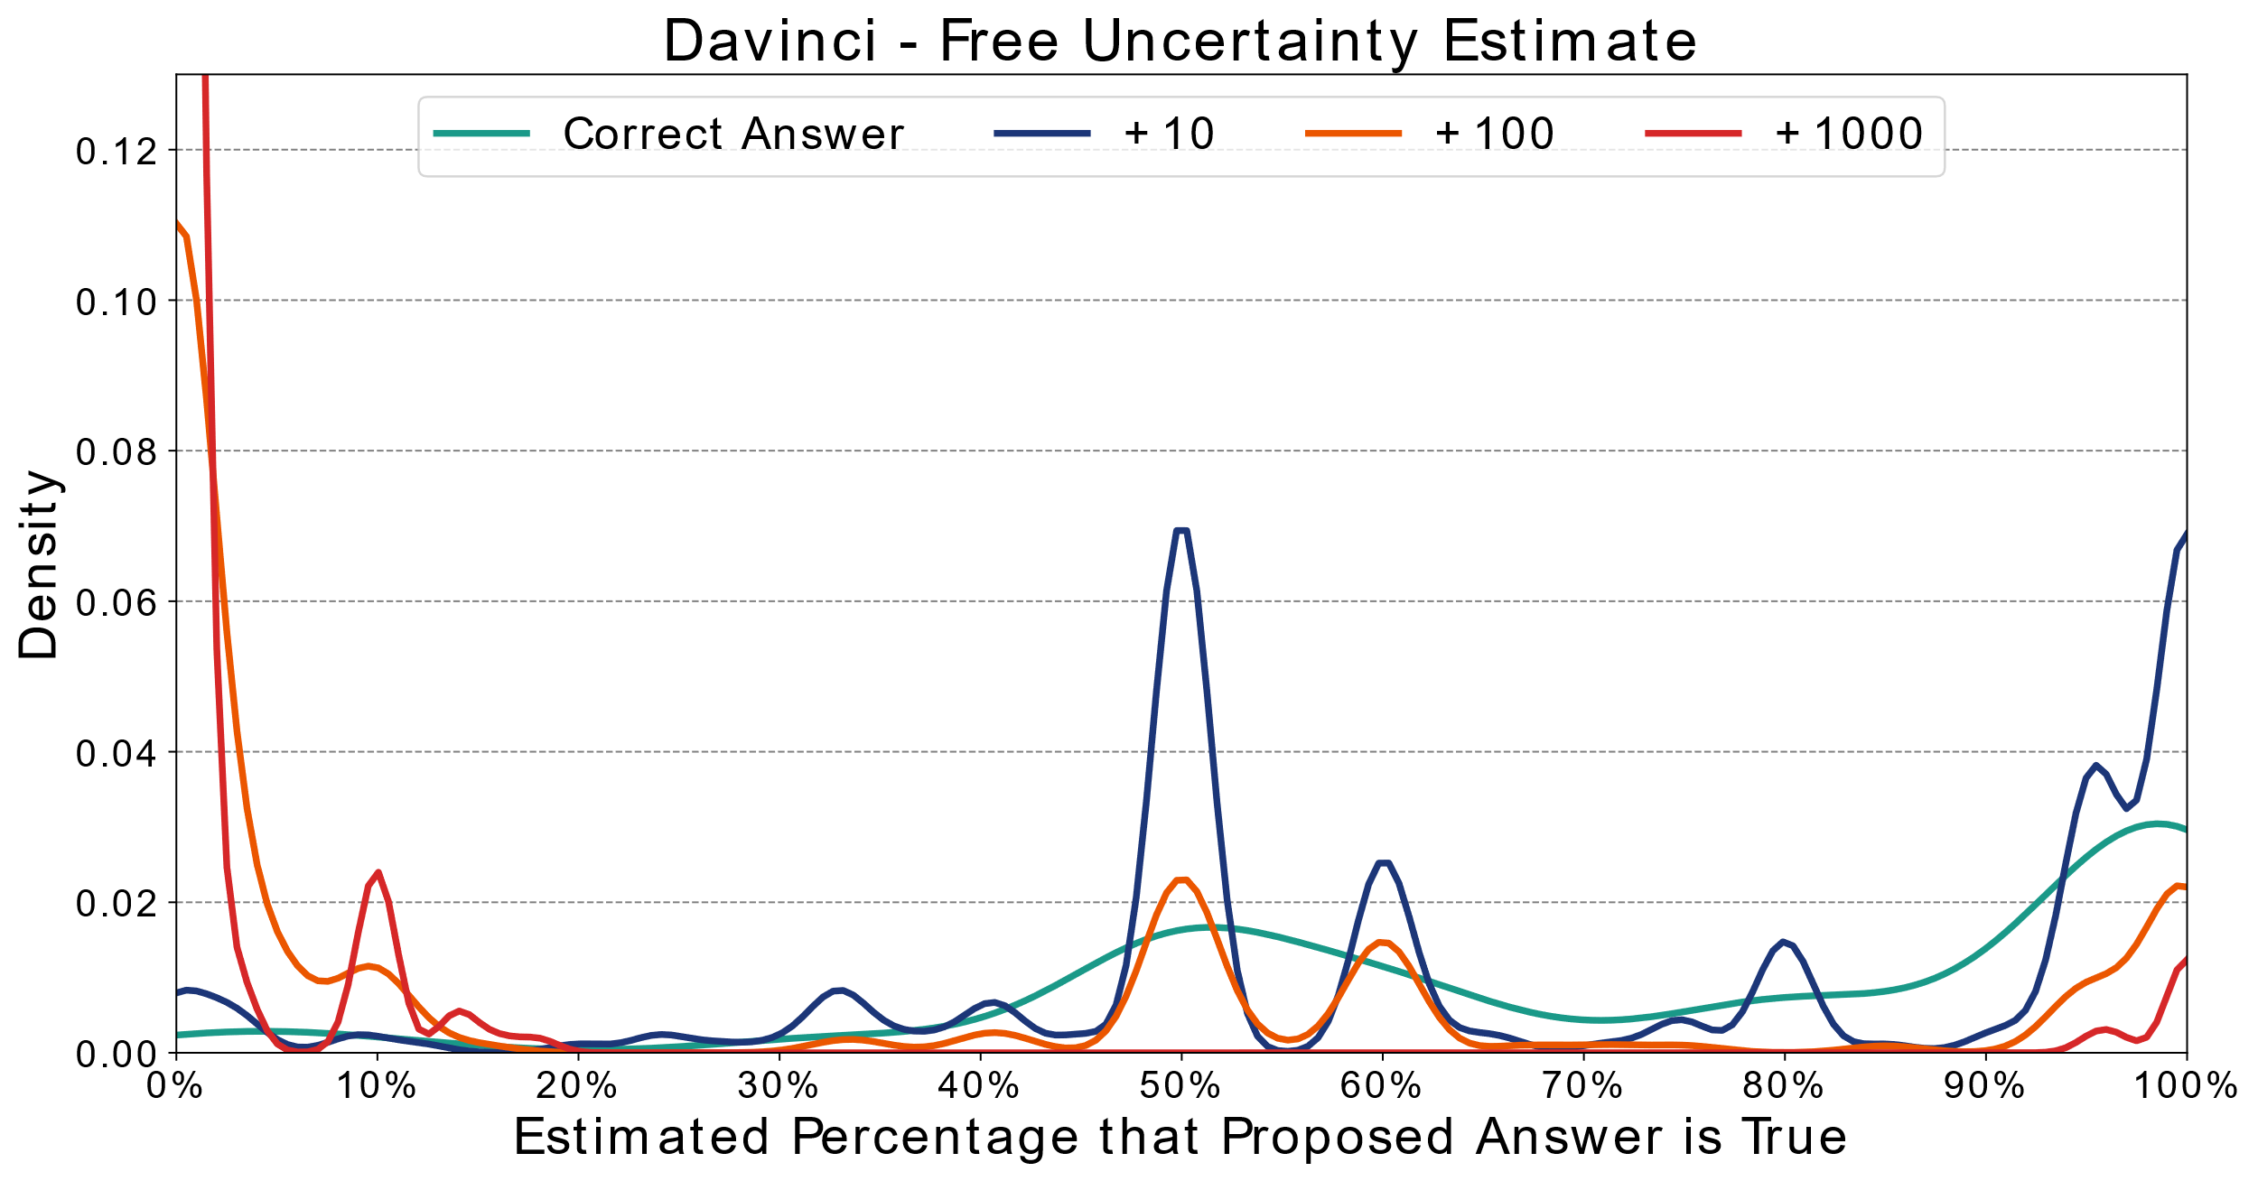
INTRODUCTION
RESEARCH QUESTIONS
MAIN FINDINGS
OUTLOOK
WEAK CALIBRATION FOR FREE UNCERTAINTY ESTIMATES
Notes:
Have to Instroduce Name „InstructGPT“

Slide 22
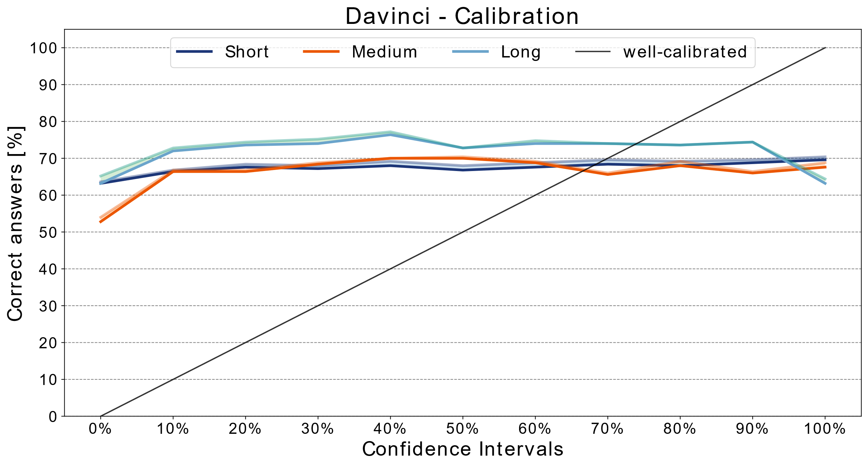
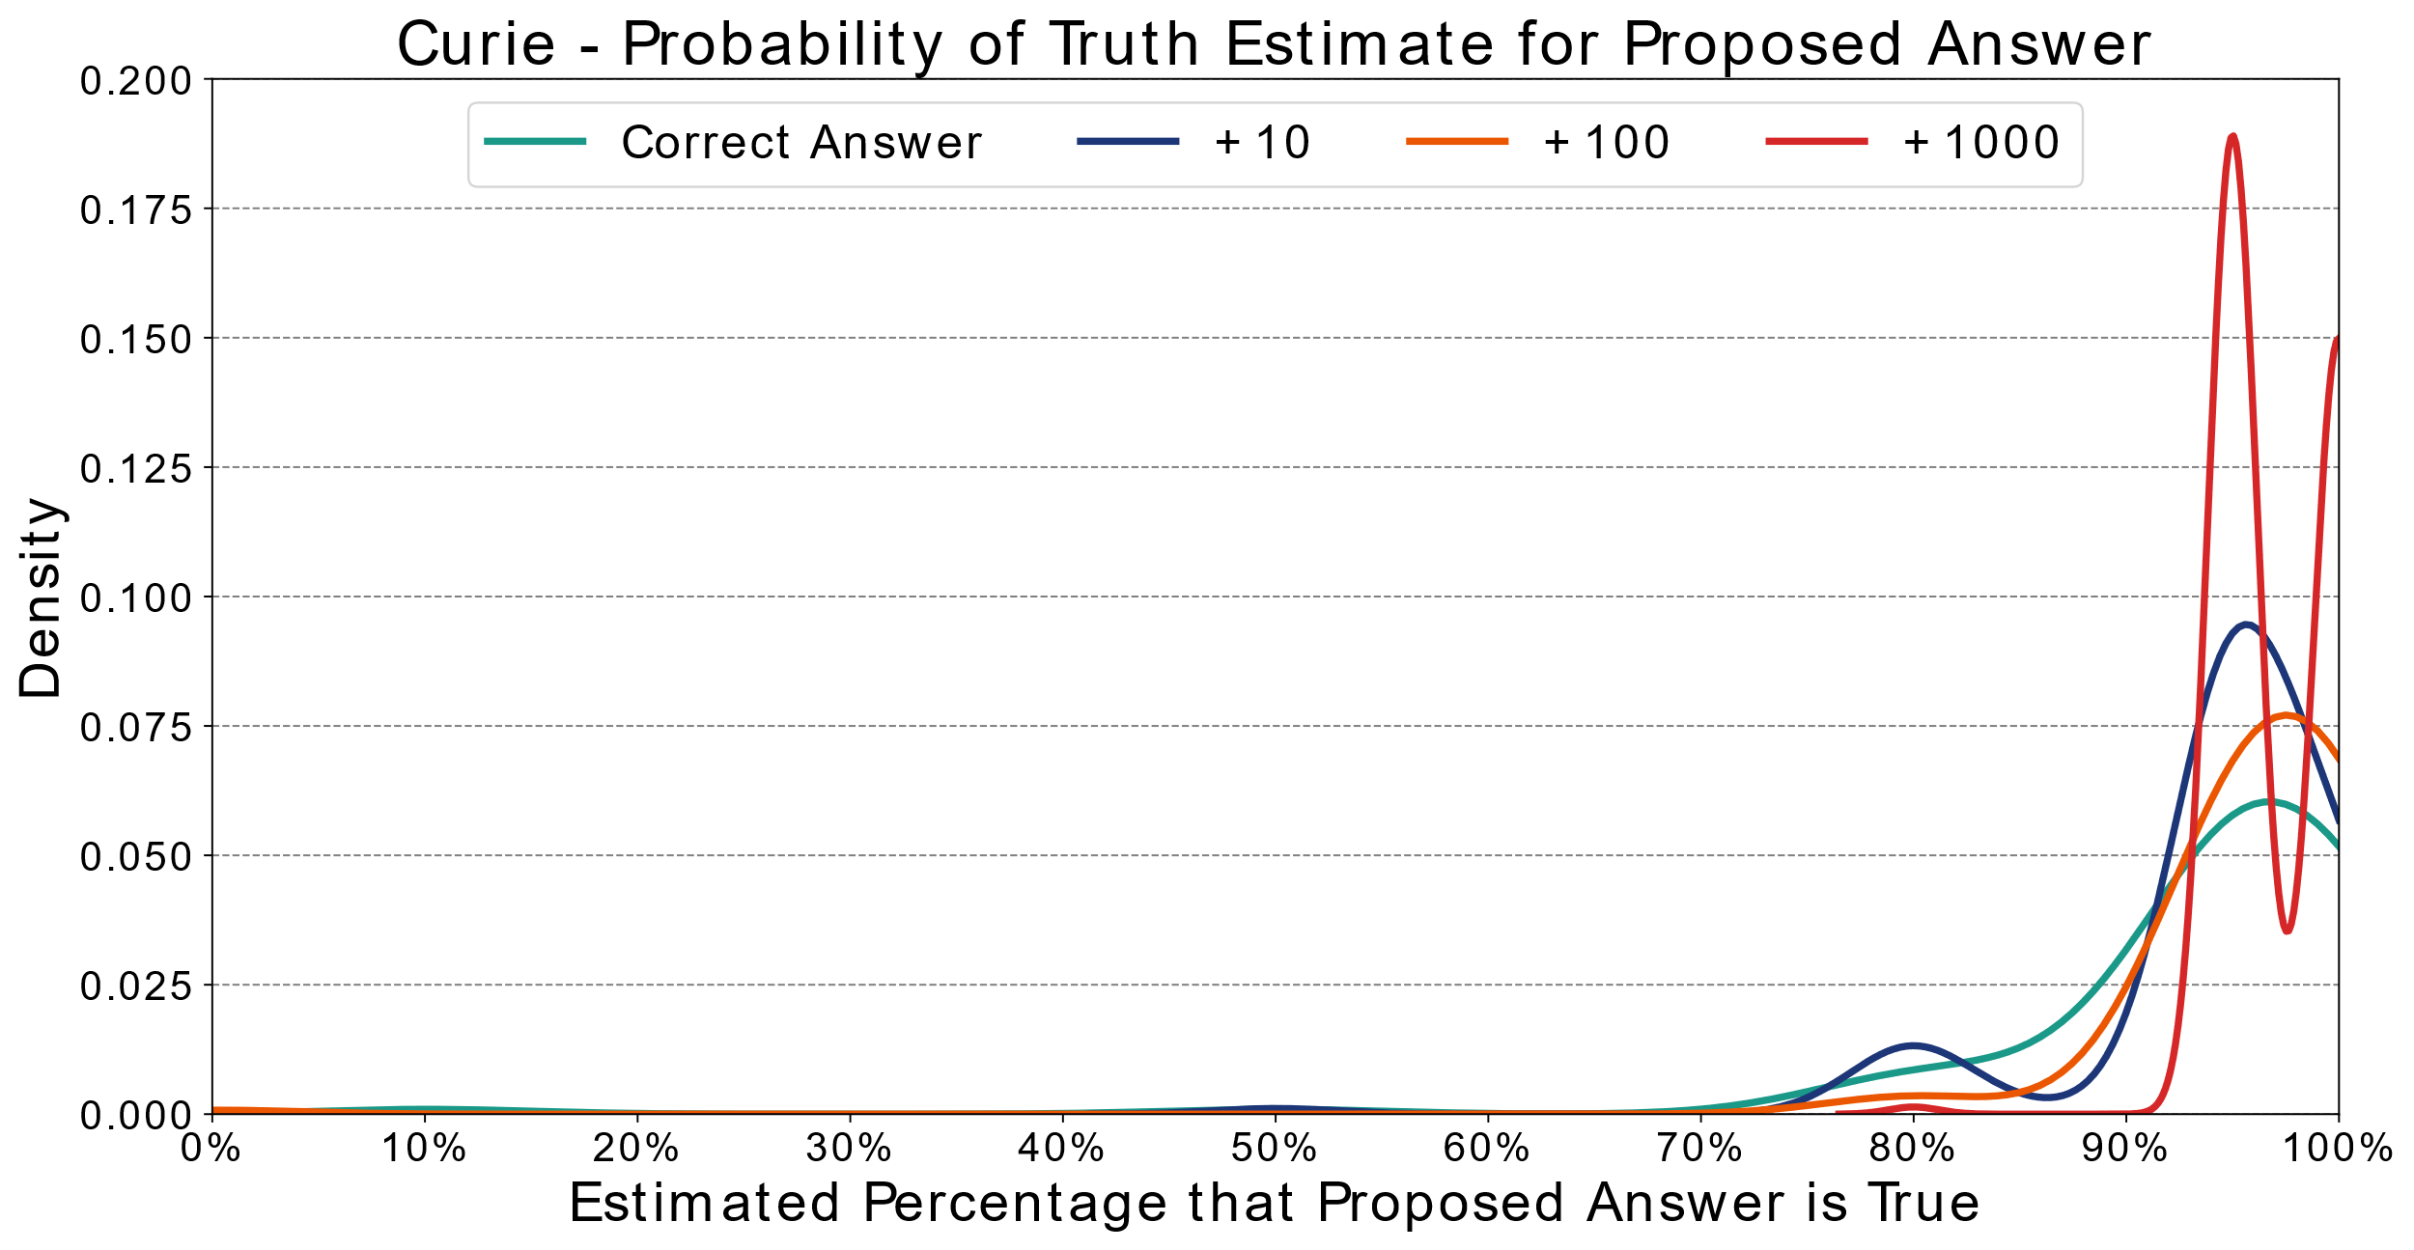
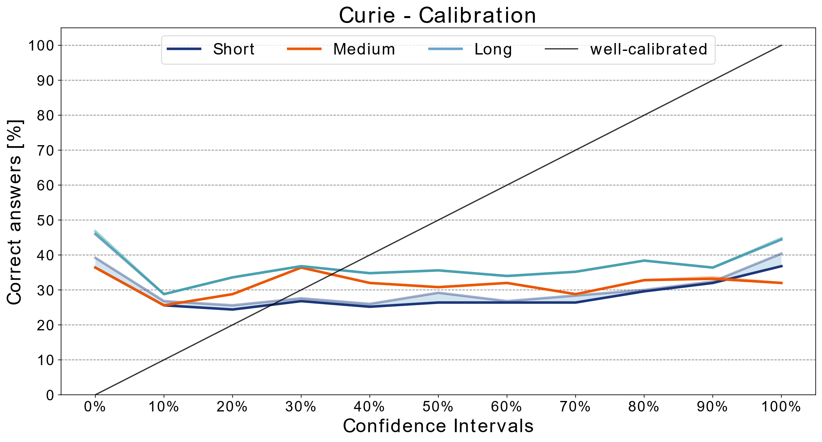
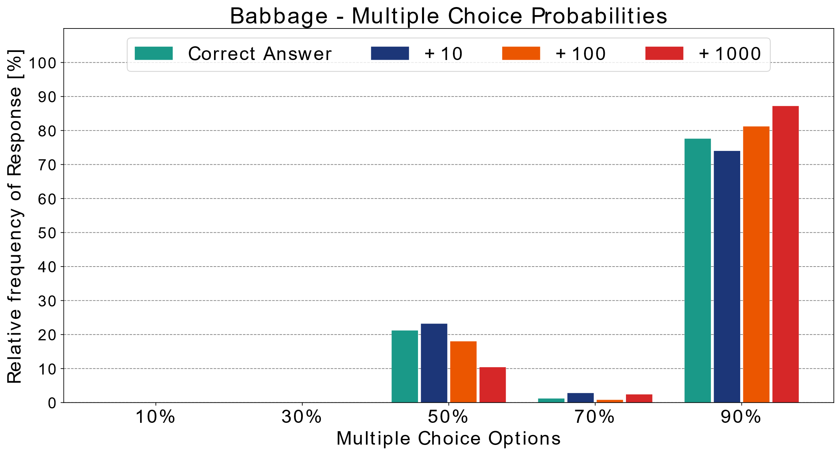
INTRODUCTION
RESEARCH QUESTIONS
MAIN FINDINGS
OUTLOOK
NO CALIBRATION FOR OTHER MODELS AND EXPERIMENTS
Notes:
Have to Instroduce Name „InstructGPT“

Slide 23

INTRODUCTION
RESEARCH QUESTIONS
MAIN FINDINGS
OUTLOOK
ROBUSTNESS TO ADVERSARIAL EXAMPLES
Variation | Text
Original
Paraphrased
German translation
Random capitalization
Insert five numbers
Replace five letters
Wrap with parenthesis
Insert 42 between letters
Notes:
My key idea is to disrupt tokenization
Generate unique strings, so that the model has to generalize

Slide 24
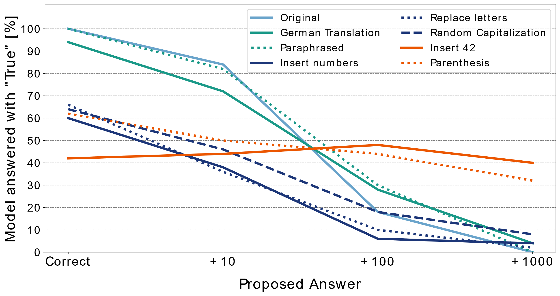
INTRODUCTION
RESEARCH QUESTIONS
MAIN FINDINGS
OUTLOOK
6. HIGH ROBUSTNESS TO ADVERSARIAL EXAMPLES

Slide 25
INTRODUCTION
RESEARCH QUESTIONS
MAIN FINDINGS
OUTLOOK
CONCLUSION
InstructGPT cannot (properly) self-evaluate its epistemic uncertainty
No calibration
Overall impressive performance
Language comprehension
Question answering ability
Ability to follow instructions
Robustness to adversarial examples
Notes:
(Implications! Give you bogus answers (content wise). People might be deceived and trust the model, because it sounds plausible.

Slide 26
INTRODUCTION
RESEARCH QUESTIONS
MAIN FINDINGS
OUTLOOK
OUTLOOK
Using few-shot learning
Fine Tuning to specific experiments
“Let’s Think step by step”
Bayesian Updating
Increase Parameter size

